Slide 1
BIS 205 Introduction to Information Management Sections 4 and 5 Dave Hemenway Hemenwayd@easternct.edu Spring 2022

Slide 2
Dave Hemenway Short Biography
I have thirty-five years of assessment, institutional research, planning and management experience in a variety of educational, business, and political environments including 8 years at Eastern. I have worked at small and large institutions in the private and public sectors and at a totally on-line adult serving college. I have been an active member of the institutional research professional community.
After retiring from full-time work, I started teaching introductory statistics courses for Eastern Connecticut State University’s Economics Department, serving on Eastern’s new Assessment Committee and being a statistics coach for doctorate students. I have also taught BIS 205- Information Systems at Eastern and similar courses at many colleges over the last 40 years.

Slide 3

I love to work on boats and sail!

Slide 4

I design and build kayaks at Cappy’s Boat Shop

Slide 5
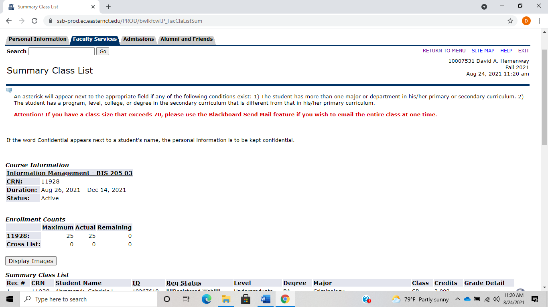
Who are You?

Slide 6
Pull up Class stats

Slide 7
BIS 205 COURSE DESCRIPTION:
“The course introduces the use of information technology for ethical problem solving and decision-making across all the functions of business. Attention is given to the critical analysis, organization, communication and presentation of information for organizational planning and control with critical reflection on project work. ”
Source: Eastern’s Catalogue

Slide 8
BIS 205 Goals
The main aim of this course is to provide students with an understanding of information technology so that they can explore applications of information systems in organizations, appreciate the impact of computers on organizations and society, foster the development of critical thinking skills in analyzing organizational problems, practice information literacy skills in handling work tasks, and promote the ethical use of digital information for greater personal and career productivity.

Slide 9
BIS 205 Course Learning Objectives
Specifically, after the completion of the course, a student will be able to:
Understand the role of digital information technology in organizations, identify relevant information sources for problem solving and be able to analyze and present their findings.
Understand important information systems used in organizations.
Apply hands-on IT personal productivity skills in information management.
Explain the technical and ethical limits of information systems in a global environment.

Slide 10
LAC Tier II Applied Information Technology Outcomes
Explain the digital representation of information (lectures and assignments)
Compare information technologies in both abstract and concrete terms (lectures, assignments, project)
Employ specific information technology to manage existing information, solve problems, and communicate or create new ideas (lectures, assignments, project)
Explain the technical and ethical limits of information systems (lectures, assignments, project)

Slide 11
Basic Information Management, Excel, and Access Skills
Pull up Knowledge for BIS 205 Students.

Slide 12
Three Liberal Arts Goals for BIS 205
A problem needs to be defined and understood before it is solved.
Follow instructions. Do what you are asked to do!
Learn how to learn.
Patience – going for a walk.

Slide 13
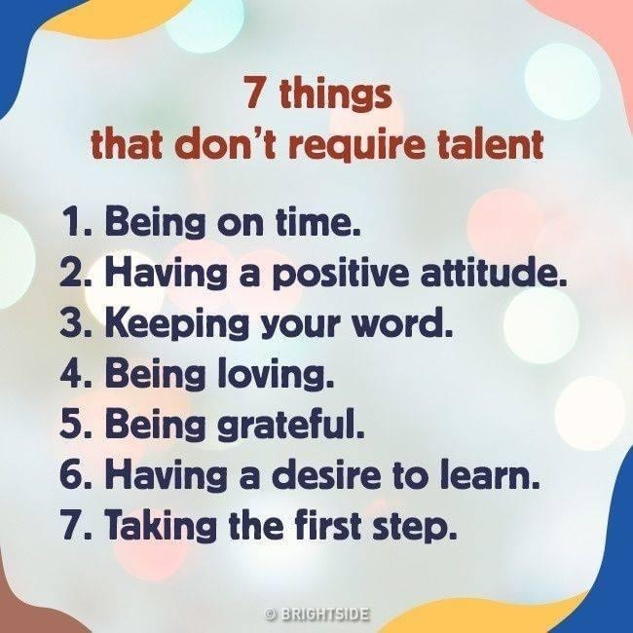

Slide 14
Data, Information, Knowledge, and Wisdom
Data
Information
Knowledge
Wisdom
Data are raw facts
Quantitative – numeric
Qualitative – descriptive
Alone is not useful
Information is processed data for a given context and specific application
Knowledge is human perception of the real world
Wisdom is the ability to apply knowledge with judgement gained from experience and study

Slide 15
Four Ways of Knowing
Text
Verbal
Tables
Visual

Slide 16
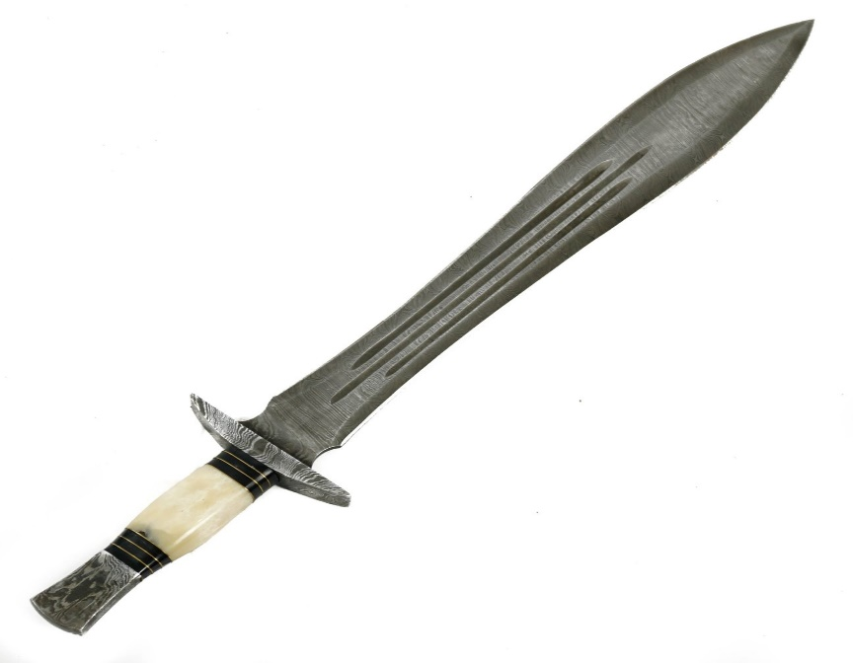
Is Technology a Double-Edged Sword?

Slide 17
Course Expectations:
Very helpful to be positive, proactive, and ask questions
There are no dumb questions
There is a large gap between understanding this material and applying it
Desire to learn
Respectful of others
Willing to put the time and effort into the course
Keep up with the class
NO one is perfect. I will make mistakes or not state things clearly.
PLEASE QUESTION ME WHEN I DO THIS.

Slide 18
Course Requirements:
Assignments are expected on due dates. They are due as set up in Blackboard and should be submitted via Blackboard.
Quizzes, projects, and exams are to be completed by YOU with no outside assistance from anyone including the Tutoring Center. They must be done on time and in the format required. All work will be submitted via Blackboard.

Slide 19
Deadlines and course requirements: Deadlines are declared when work is assigned/announced and is due at the beginning of class or as stated in Blackboard. No extensions. Legitimate reasons for missing any of the course requirements such as sickness, job interviews, school team event require notification and proof before deadline. If you think you have a legitimate reason, contact me via email ASAP, with your documentation.
Attendance: Is required and will be recorded each class. If I can not make a class, we may hold a Zoom class for that day.
Grading: Your work in this course will be evaluated by quizzes (50%), tests (25%), projects (25%), and classwork/attendance.
The grading scale will be 93-100 =A; 90-92=A-; 87-89=B+; 83-86=B; 80-82=B-; 77-79=C+; 72-76=C; 70-72=C-; 67-69=D+; 63-66=D; 62 or less=F.

Slide 21
Resources
Information Systems for Business and Beyond (2019)
David Bourgeois, Joseph Mortati, Shouhong Wang, James Smith
Open Textbook Challenge, 2019
Beginning Excel
Noreen Brown, Barbara Lave, Julie Romey, Mary Schatz, Diane Shingledecker
Open Oregon Educational Resources, 2017
Microsoft Office 2019
Peter Weverka
John Wiley and Sons, 2019
Office, Excel, and Access Tutorials
Goodwill Community Foundation
edu.gcfglobal.org

Slide 22
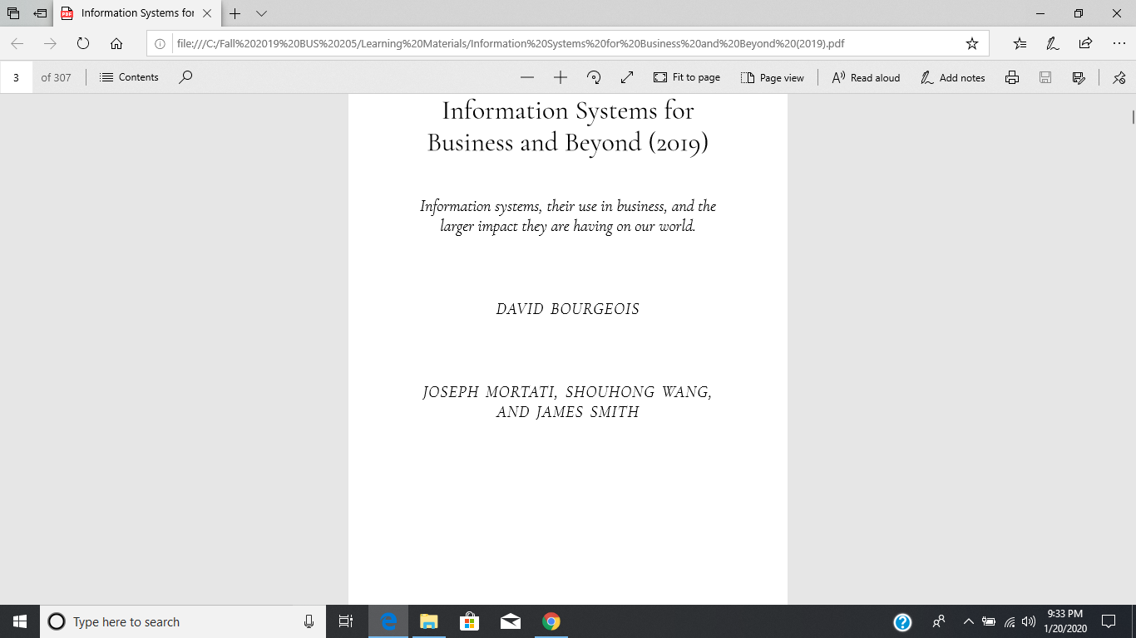

Slide 23
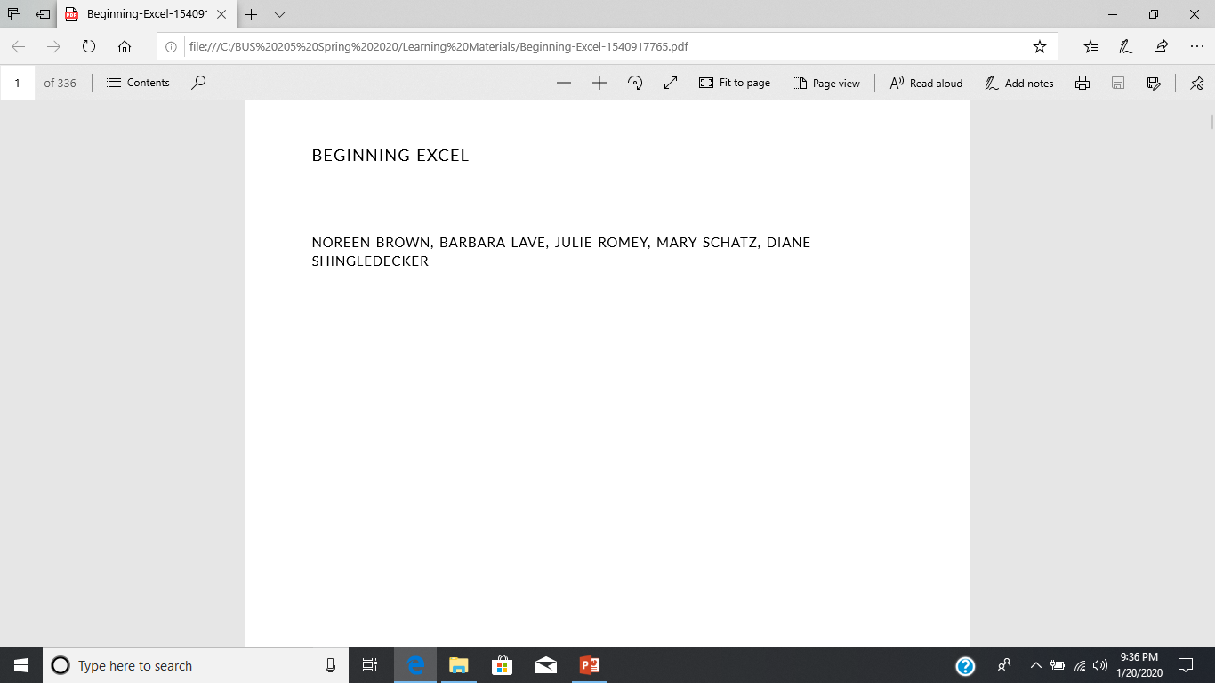

Slide 24
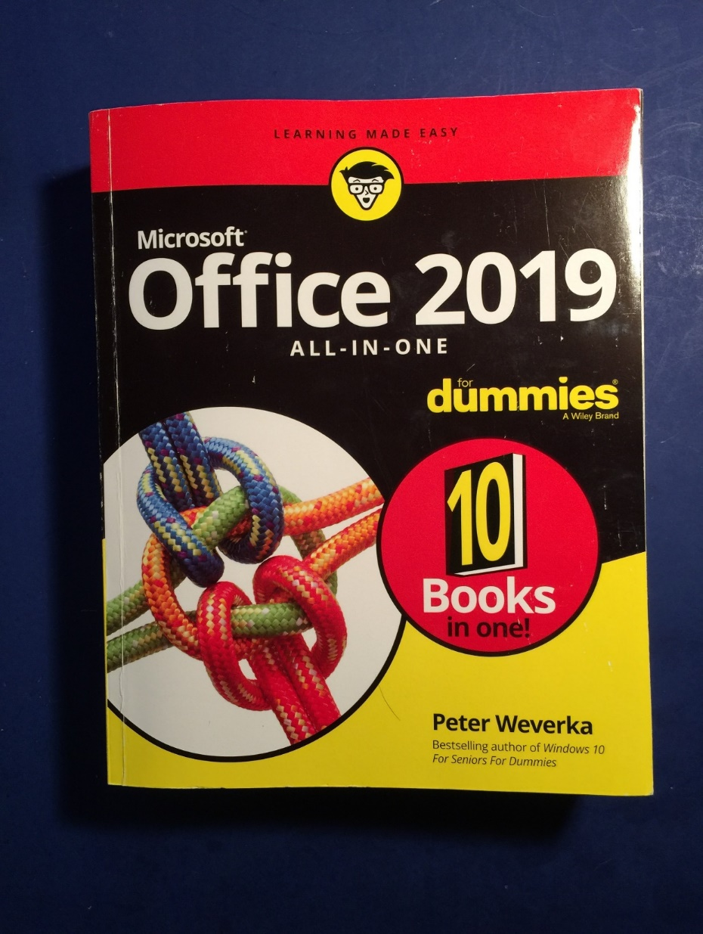

Slide 25
Goodwill Community Foundation
This organization has developed and distributed a number of tutorials on most aspects of the Microsoft Office Suite and other applications for more than twenty years. These free tutorials are easy to follow and are not technically oriented- they teach the practical use of the software.
edu.gcfglobal.org
edu.gcfglobal.org/en/excel
edu.gcfglobal.org/en/access

Slide 26
Goodwill Community Foundation - Excel
Getting Started with Excel
Understanding OneDrive
Creating and Opening Workbooks
Saving and Sharing Workbooks
Cell Basics
Modifying Columns, Rows, and Cells
Formatting Cells
Understanding Number Formats
Working with Multiple Worksheets
Using Find & Replace
Checking Spelling
Page Layout and Printing
Intro to Formulas
Creating More Complex Formulas
Relative and Absolute Cell References
Functions
Basic Tips for Working with Data
Freezing Panes and View Options
Sorting Data
Filtering Data
Groups and Subtotals
Tables
Charts
Conditional Formatting
Comments and Co-authoring
Inspecting and Protecting Workbooks
Intro to PivotTables
What-if Analysis

Slide 27
Goodwill Community Foundation - Access
Introduction to Databases
Introduction to Objects
Getting Started in Access
Managing Databases and Objects
Working with Tables
Working with Forms
Sorting and Filtering Records
Designing a Simple Query
Designing a Multi-table Query
More Query Design Options
Creating Reports
Advanced Report Options
Modifying Tables
Creating Forms
Formatting Forms
Designing Your Own Database
How to Create Calculated Fields and Totals Rows
How to Create a Parameter Query
Creating a Parameter Query
Query Criteria quick Reference Guide

Slide 28
Challenges
Protect yourself and others from COVID. If you don’t feel well, don’t come to class. If I think I have COVID, I may teach that day’s class via Zoom. Masks are required at all times as per Eastern’s Covid protocol.
Please download and install the latest version of Office that is available for free from Eastern.
Access- the personal computer-based database program that we will use for the second half of the course does not easily run on an Apple.
Do what you are asked to do in a timely fashion- not right before the due date.

Slide 29
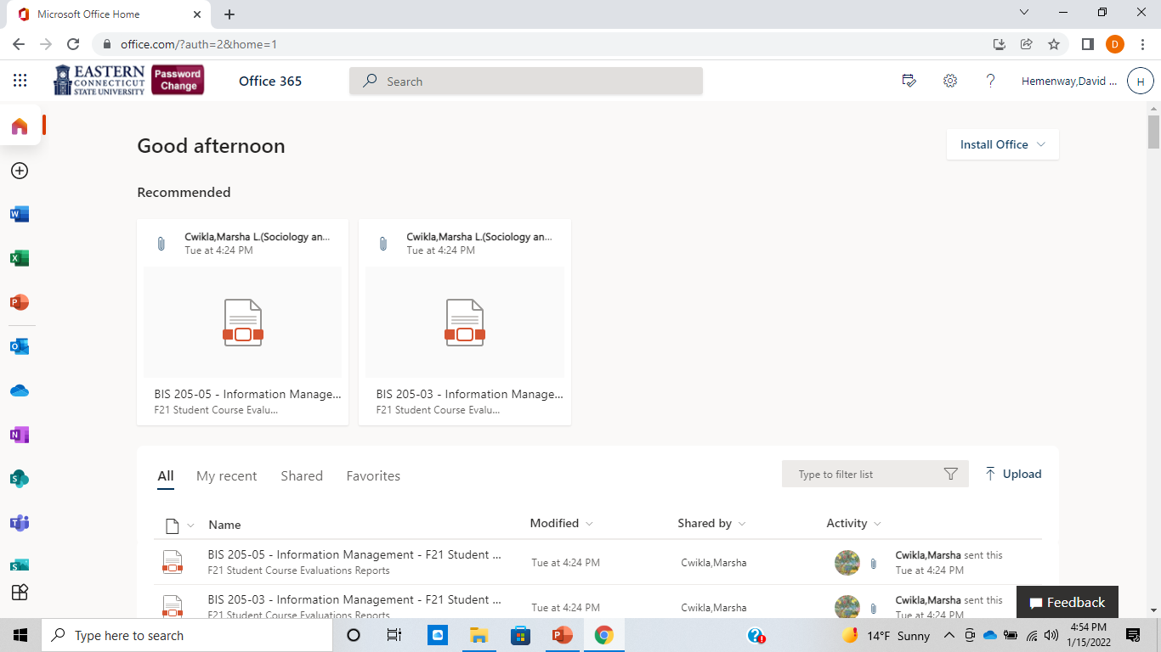

Slide 30
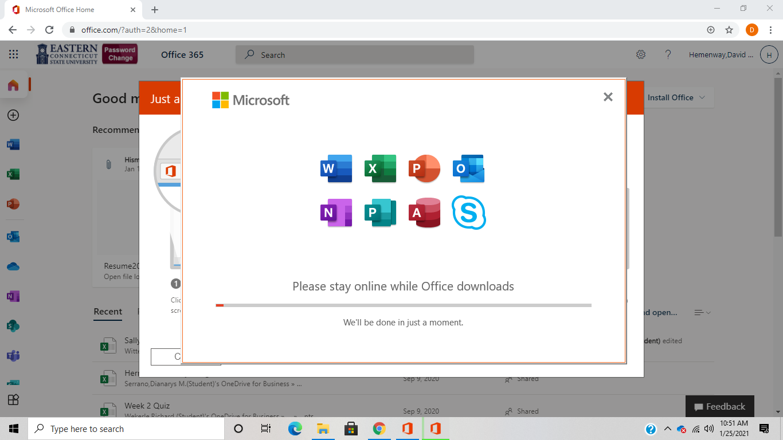

Slide 31
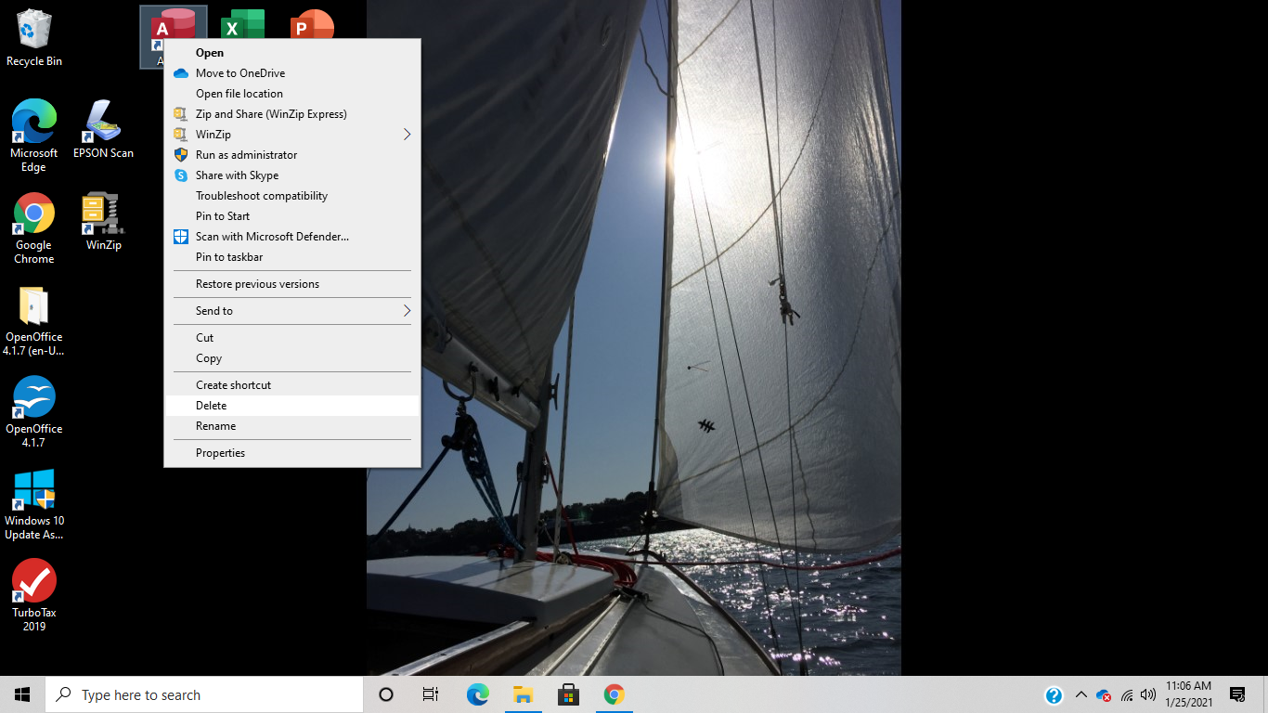

Slide 32
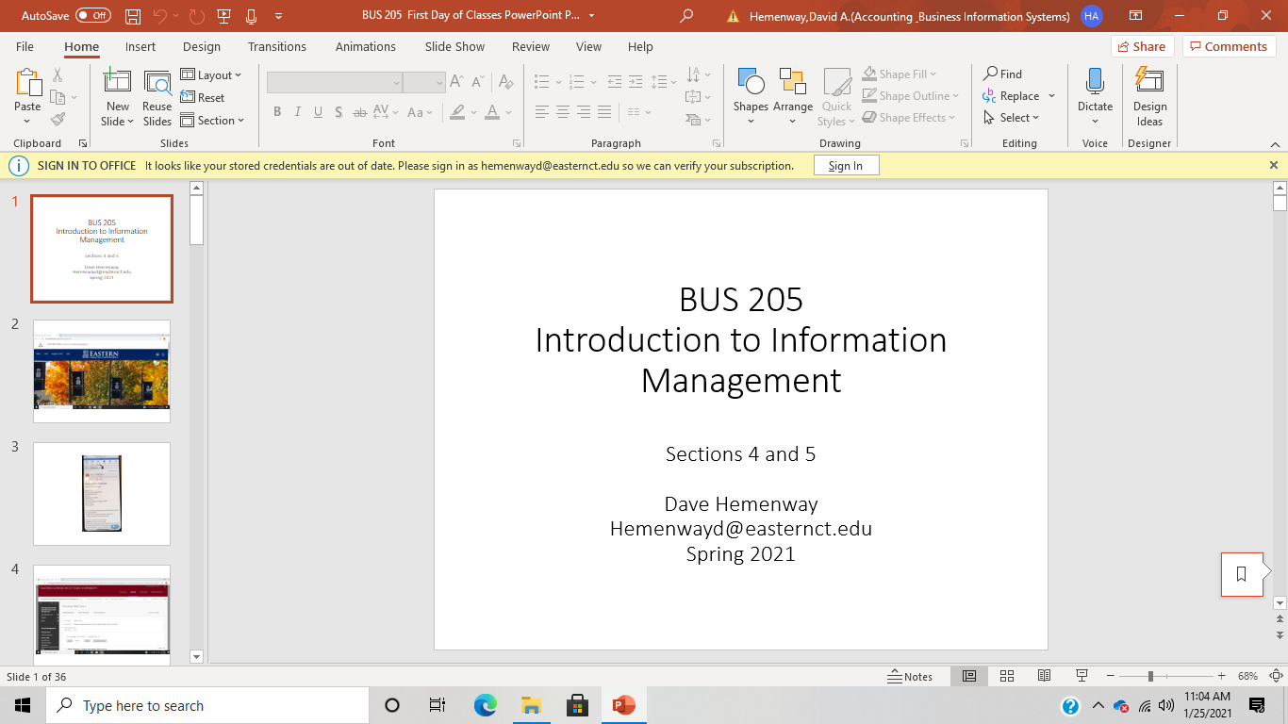

Slide 33
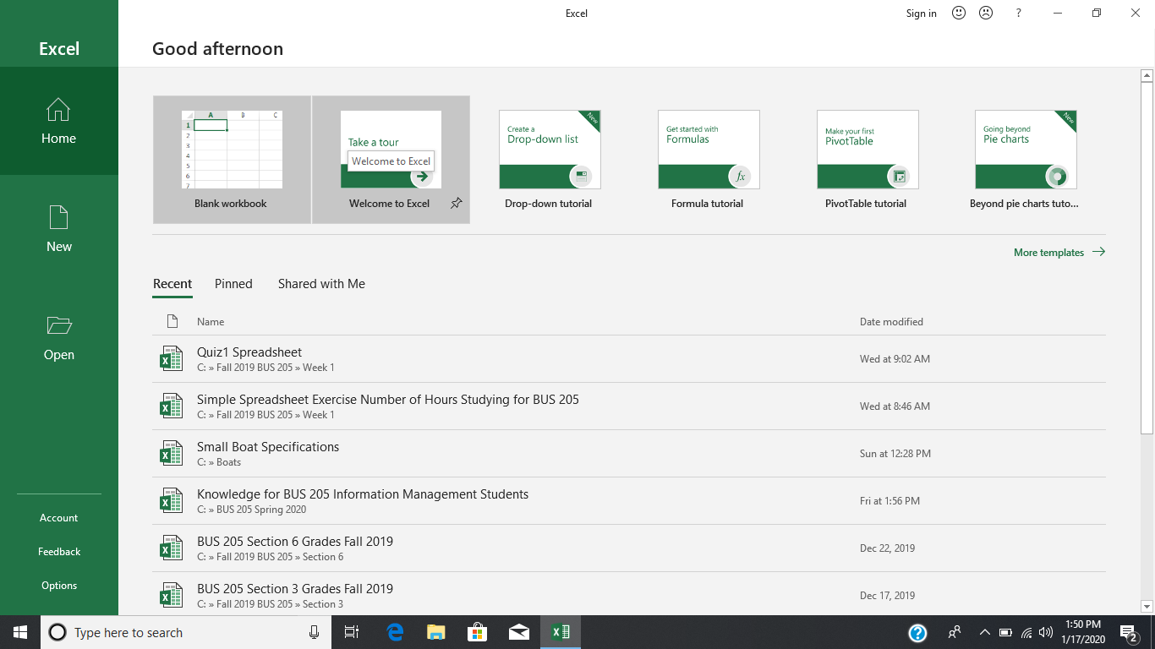
Excel

Slide 34
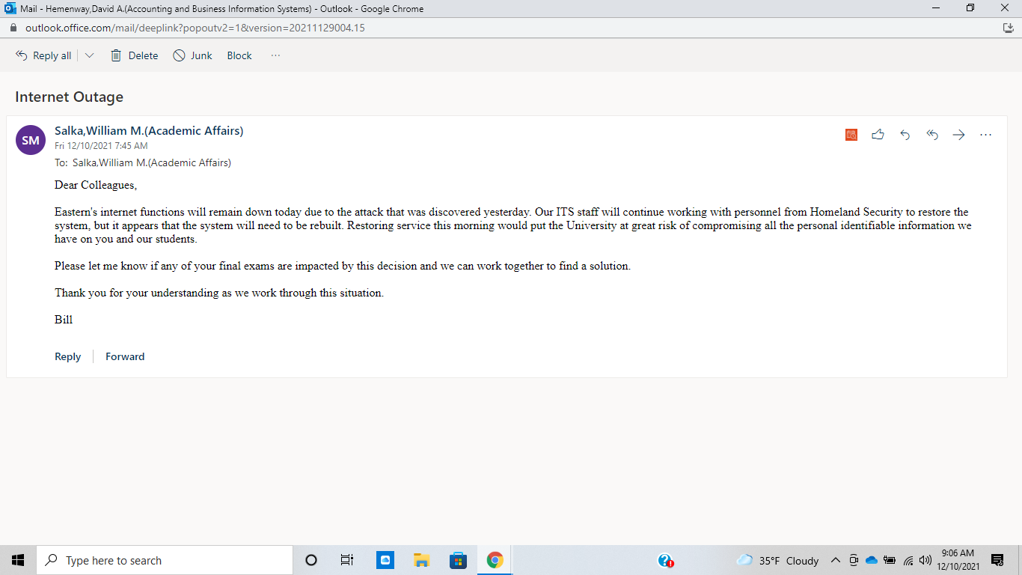

Slide 35
Random Thoughts:
Use the CASE approach:
Copy and Steal Everything….thank profusely
When frustrated by technology:
Feet don’t fail me now…. Go for a walk!
Everyone makes mistakes:
It’s not a mistake if you correct it!

Slide 36
First Assignments
Write a one- or two-page (200 to 400 words) essay explaining what you want to learn in BIS 205 Information Management and describe any challenges you may have in learning this material. This first assignment must be written using Microsoft Word and is due Thursday, January 20th by 11:59 PM via Blackboard.
If unfamiliar with Excel, do some Excel tutorials.
Read Chapter 1 of Bourgeois, Information Systems for Business and Beyond (2019).

